Slide 1
VCSE Workshop Evaluation
Brief Feedback Summary

Slide 2
Overall Sentiment
Feedback strongly positive.
Participants highlight support, collaboration, and networking.
Very few negative comments, mostly about external challenges.

Slide 3
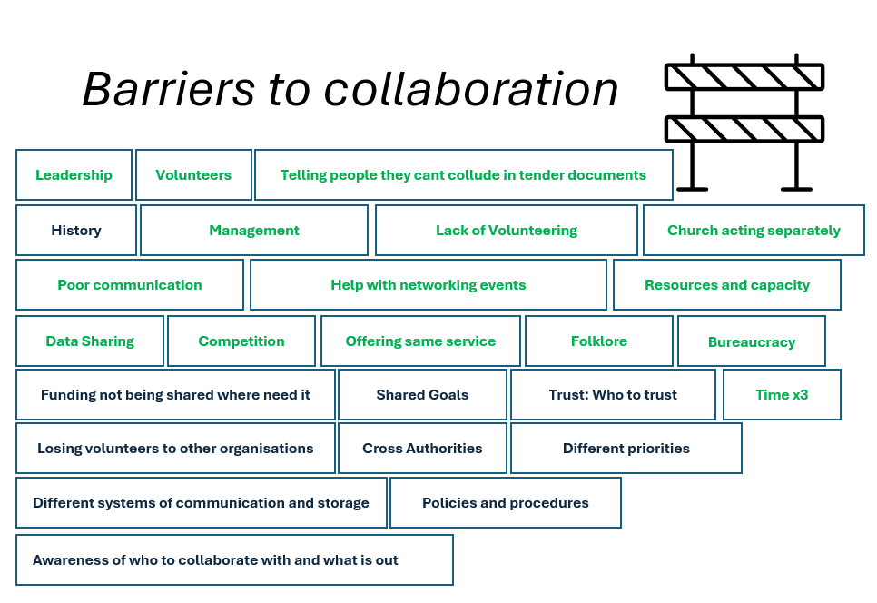

Slide 4
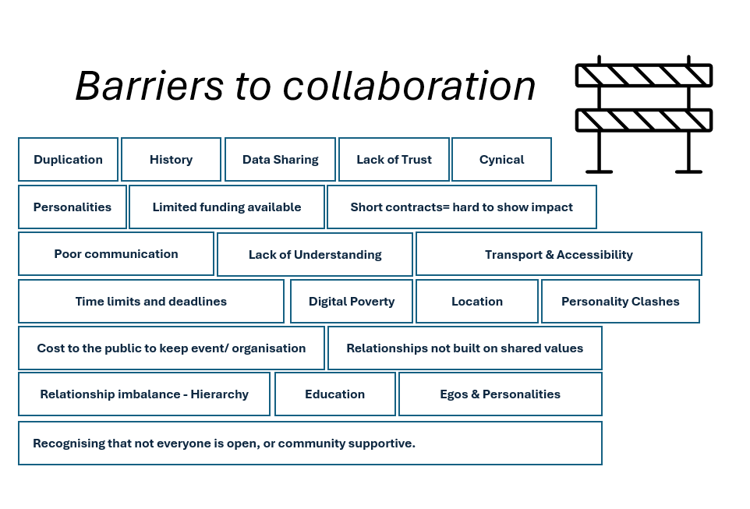

Slide 5
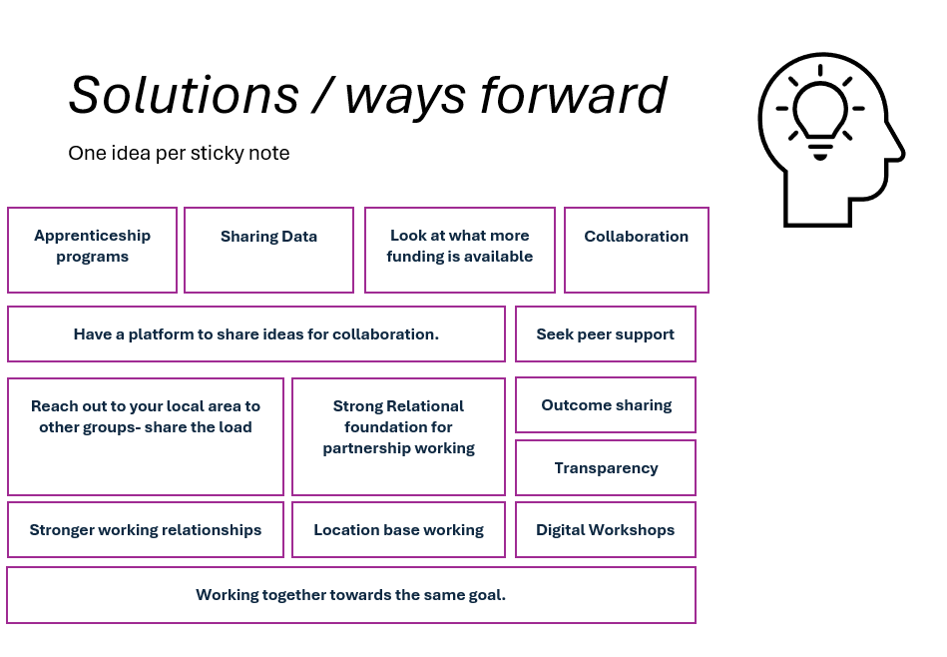

Slide 6
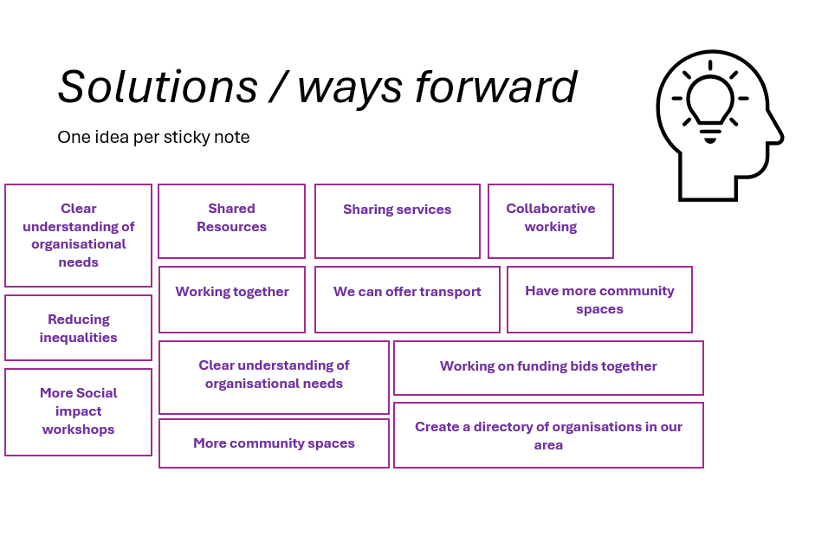

Slide 7
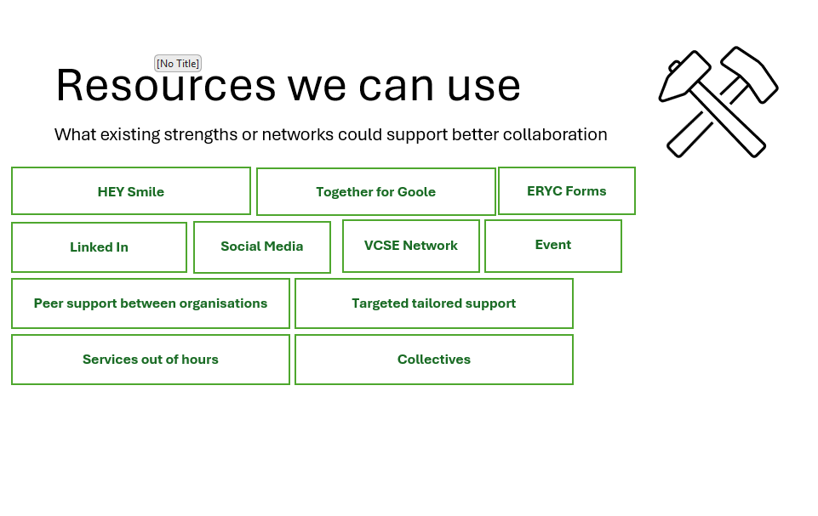

Slide 8
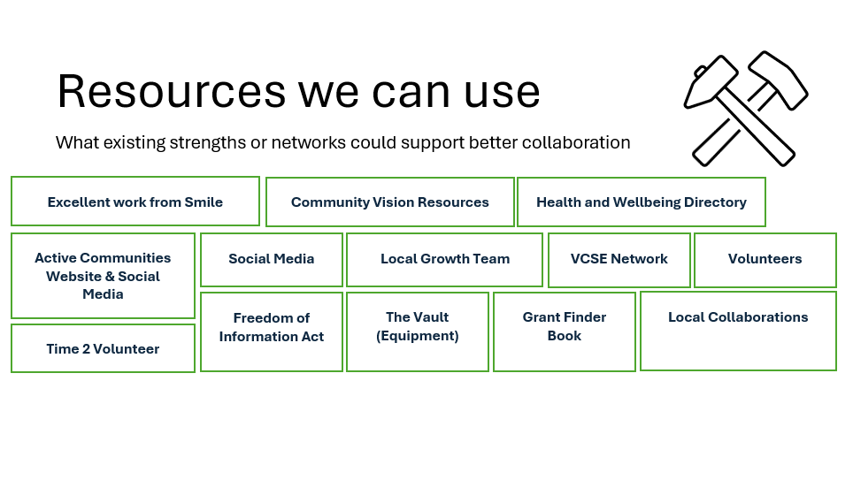

Slide 9
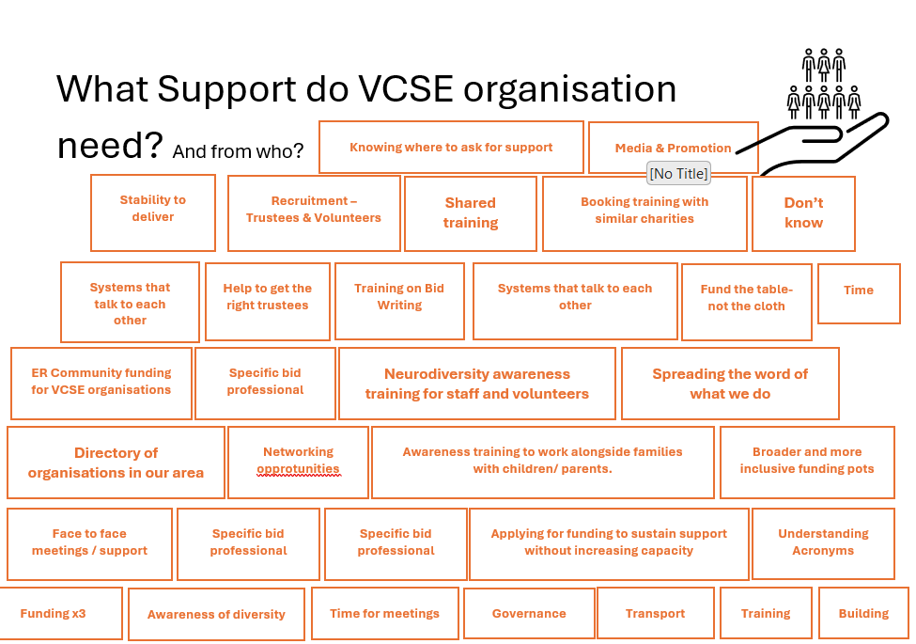

Slide 10
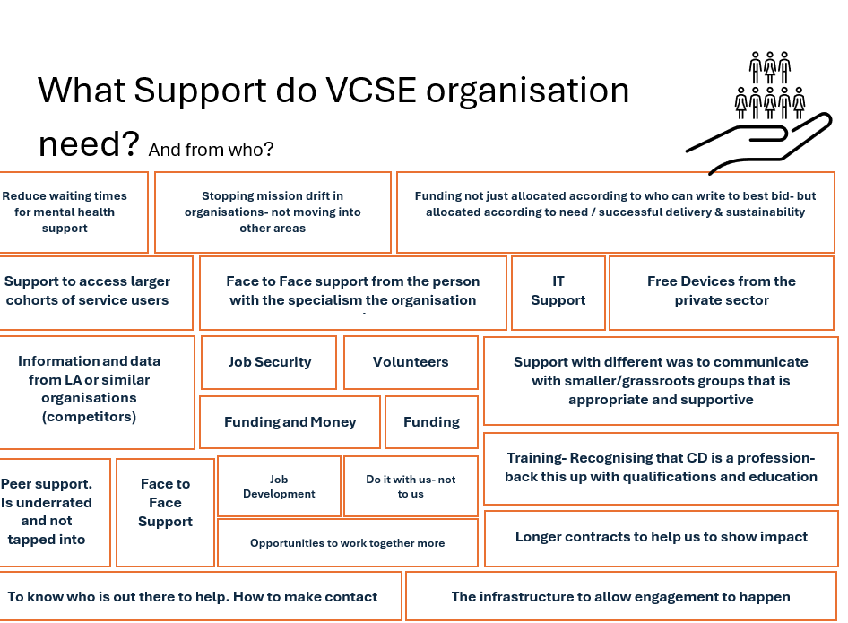

Slide 11
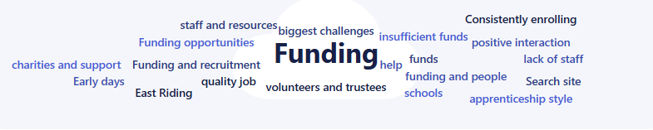
Biggest Organisational Challenges
Funding pressures and sustainability.
Digital and online presence.
Volunteer recruitment.
Community engagement.

Slide 12
What Next
More skills-based workshops.
Additional networking meetups.
Look at how to help with funding and grant writing.
Digital training sessions.
Opportunities for cross-organisation collaboration.

