Slide 1


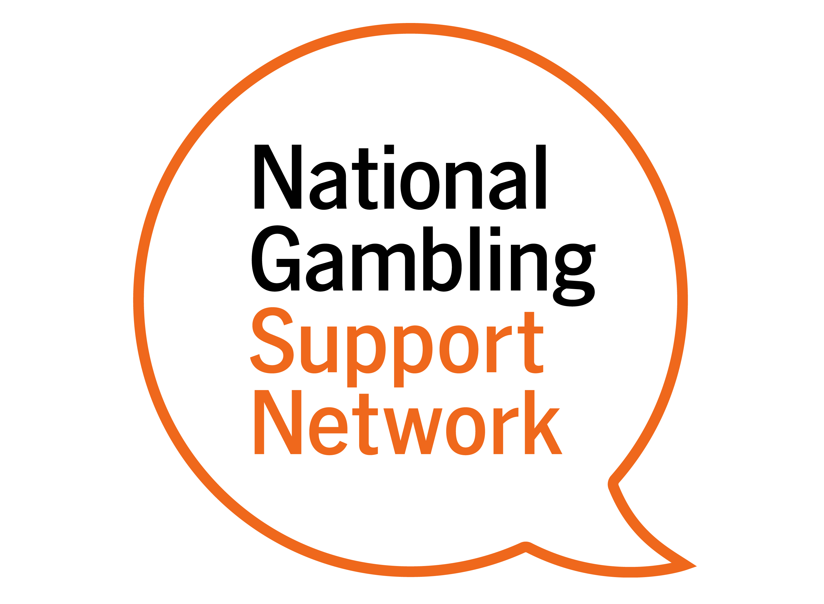

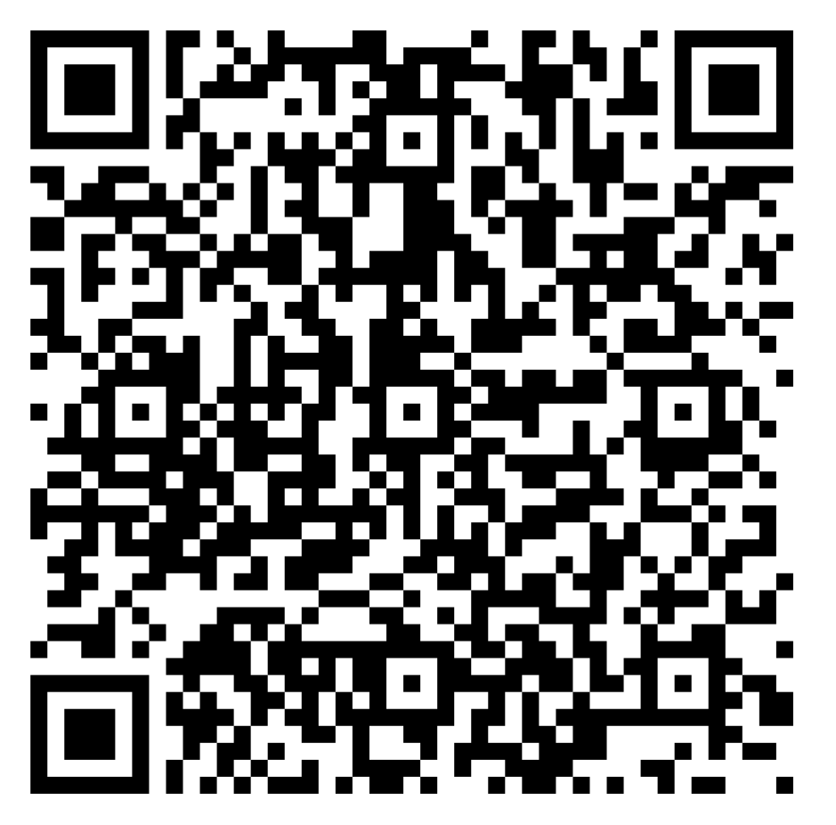
NECA Gambling Related Harms Champions
Our team of Gambling Practitioners provide free, confidential, support services.
We offer:
Advice
Tailored support
Awareness Training to professionals and wider community groups.
We would like to increase awareness of gambling related harms and the support that is available to anyone affected.
NECA will provide you and your organisation with tools to identify gambling related harms, and any potential triggers alongside clear referral pathways into our services. We would value working in partnership with you and your organisation.
What will it mean for me?
As a Gambling Champion, you will be the point of contact within your organisation. If people need; Leaflets/resources or awareness of support and pathways into services.
Our commitment to you -
We will supply resources and support to ensure this will have minimal impact on your current role. We will also provide gambling related harms awareness sessions to add to your portfolio of skills.
We would welcome all our Gambling Champions at our quarterly events, either face to face or via zoom. This will provide the opportunity to network with other services, share examples of good practice and support each other.
Please feel free to message gambling.northeast@neca.co.uk if you have any questions.
If you would be happy to sign up
to our Champions Charter,
please scan the QR code

