Slide 1
East Ridings
Stronger Together Approach
Insert version number – EG: V1.0 Jan 24
Notes:
Introductions:

Slide 2
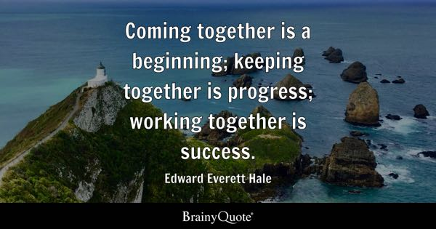
Notes:
How to we come together???? This is the first step, without this we do not have progress or success.
Working Together to Safeguarding Children 2023 and the National Framework for Children Social Care 2023

Slide 3
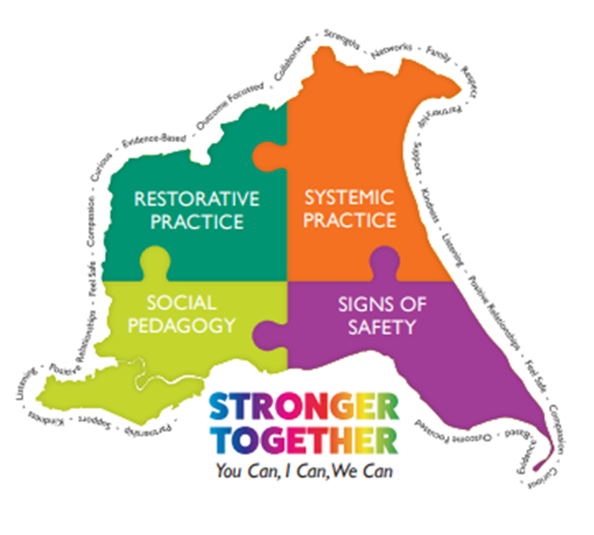
What is the Stronger Together Approach?
Notes:
The Stronger Together Approach a relational approach and a way of working together with children, families, colleges and partners.
In 2021 ER Childrens Safeguarding and Support Services and Early Help and Prevention developed a model of practice to embed a consistent approach to the work which was being carried out with Children, young people and families and across the services. Prior to this is was seen that we were working in silo’s and communications required improvement on all levels.
Signs of Safety is the framework which is used by East Riding’s CYPSSS and Early Help and Prevention (Hull, York, East Lins), this is a strength based, solution focussed, relational approach to safeguarding children, young people and families.
With this in mind the Stronger Together Approach is a relational approach to practice, it has taken its theory and knowledge from three Social Sciences Restorative Practice, Social Pedagogy and Systemic Practice and used the Signs of Safety as the Golden Thread that runs throughout.
This is an approach which is now used across Children, Families and Schools directorate and is shared with Adult Social Care, Targeted services, YJS, SEND and partners, Police, Health, Fire brigade and voluntary sector and those who sit alongside Children, young people and families to support them.
By us sharing the knowledge and understanding of this approach it is hoped that the children and families we support have a more consistent approach to the support they receive from all parties and also the relationships between those supporting have clearer communication and are all understanding of each others role in supporting a family and child. We can sometimes have our own agenda or lens and working together give an holistic wrap round support.

Slide 4
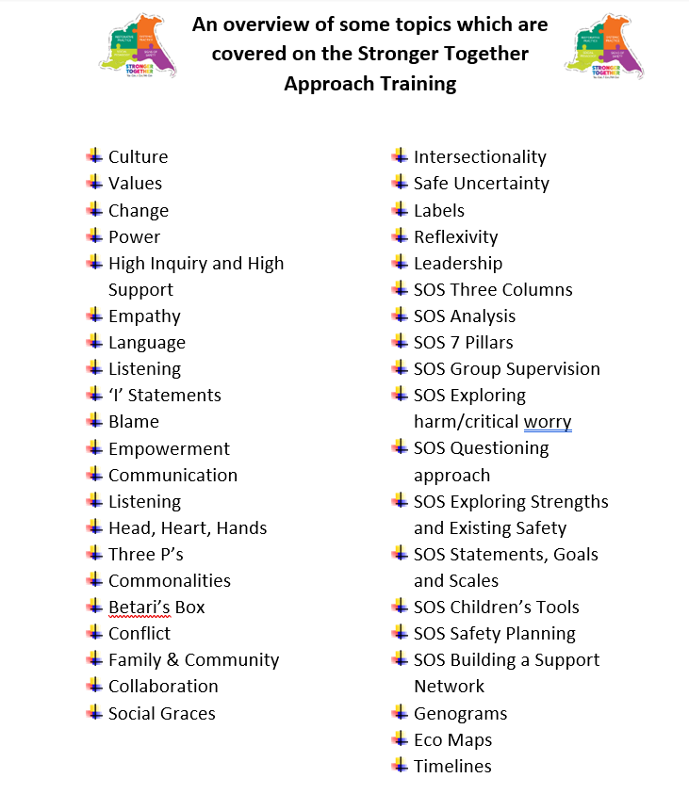
What is the Stronger Together Approach?

Slide 5
How do we know this is making a difference?
· ‘
Parents/Carers Families/Children | Workforce | Professionals and Partners
· ‘Once again, thank you so so much for understanding and supporting without judgement.’ – Children’s Centre
‘It has been refreshing to work with a Social Worker who has displayed passion in understanding the individual SEND and how it affects the family dynamics, and (Worker) has been vigilant in identifying needs and matching support to those needs without judgement. – 0-25 SEND Team to SSF
‘you really created a team around (Young person) and the family so everyone was working on the same page.’ – Caritas to Children with Disabilities Team
"Thank you for everything you did for us at the contact centre, you made an unnatural situation feel so relaxed and we made the best of it and you probably saw us build our bond back over that time." - Family Time
‘I want to express my very real gratitude in particular to (worker) for an extremely professional piece of work in assessing (Family names), and clearly setting out the results of that piece of work in her final statement. It is no surprise to me that the couple express themselves as they do because in putting them at ease, as is evident she did, (Worker) has been able to provide the court with a very insightful picture of their lives, attitudes, their concerns about the present and future in a very realistic way.’ – Barrister to SSF
‘(Worker) said to me that she has never worked within a Local Authority where the team are so supportive of one another and come together when there is a crisis like this to ensure that all paperwork and all tasks are completed when the local authority enters care proceedings’ – Children’s Assessment Service
‘We will never forget your passion, commitment and your ability to challenge when you felt Young Person was oppressed by his LAC status!’ - IRO
“I liked her, she’s good, she just listened to you, she was chilled out and would go through the work slowly”. – Youth Justice Service
‘she is a very pleasant, patient young lady. She is very calm and kind when working with the children. Listens to the concerns shared and takes the thoughts and feelings of us that know the children into account'. – School to CAS
‘I like how you guys work as managers, I love the team, the way people laugh, it’s really nice, don’t change’ – Agency Social Worker to CAS
Notes:
Spread the word
Email stronger together

Slide 6
Notes:
Talk through the three different way to access training
1 x Video
1 x e-learning
2 x Face to Face

Slide 7
“Each one of us can make a difference, together we can make a change”
Barbara Miluski
Notes:
Trainer to identify a scaling question.

Slide 8
Any Questions?
Notes:
Trainer to ask the group a check out question to end the session.

